Slide 1
DIGITAL SIGNAGE
RAHUL KAKKAR

Slide 2
Value Proposition
The problem…
The Digital Signage project has addressed the opportunity of having “interactive kiosk” like system, featuring specialised hardware and software that will provide access to the Polytechnic information .
The solution…
Research on “how signage system works”.
Developed a Signage system.
Notes:
Did research on what is digital signage, where is it been used

Slide 3
Functional Requirements
The System Shall
… deliver information to digital screens around the campus.
…allow admin to add/update/delete or upload the information.
…allow visitors to interact with the screen.

Slide 4
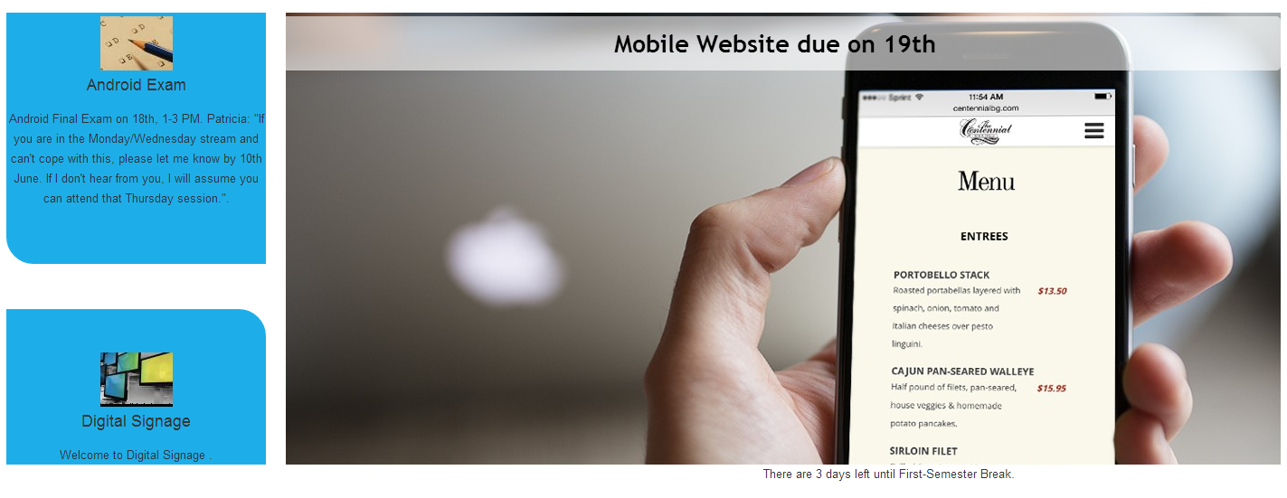
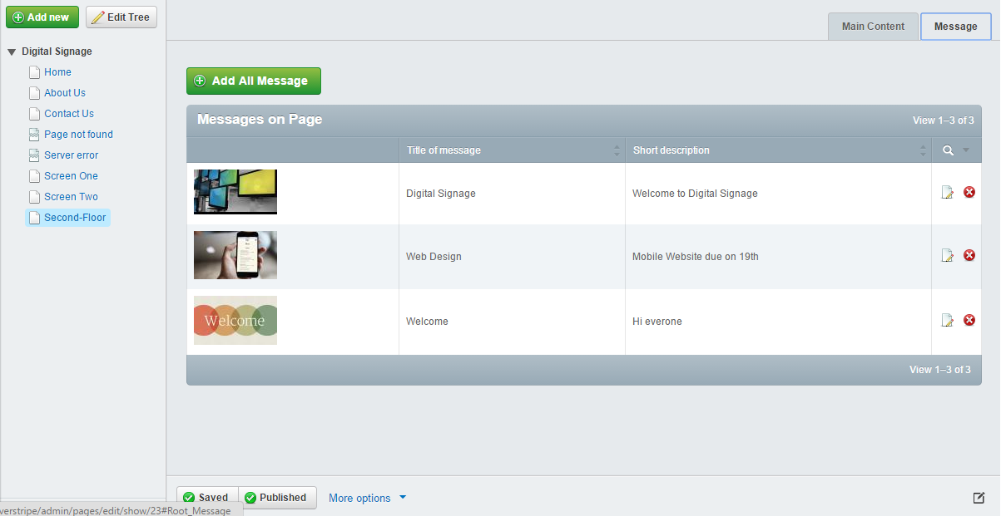
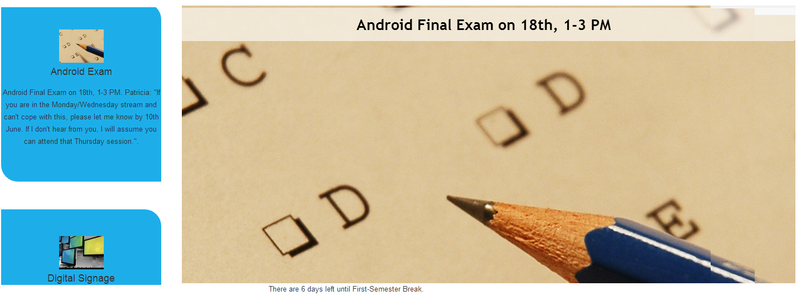
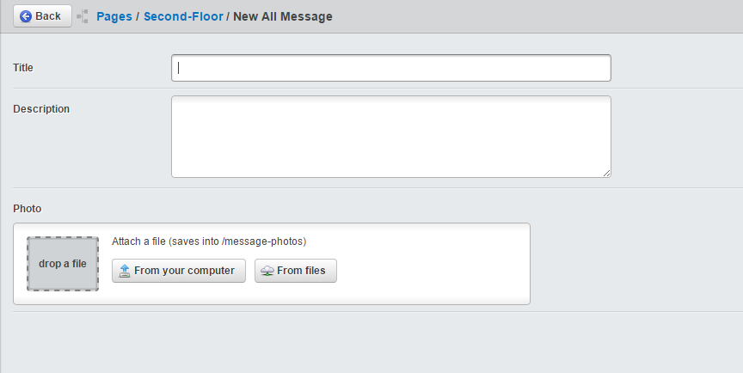
MVP

Slide 5
Important lessons.
Documentation .
Meetings.
Personal Milestones.
Notes:
Keeping logs of every research or changes. I realized during end of project 1 that few documents have been overwritten and no history of changes made to the document was stored.
Since start of project 2 I am keeping record of every change.
More and more meetings with the stakeholders to make sure project is going towards right direction.
Keep them updated of the changes .

Slide 6
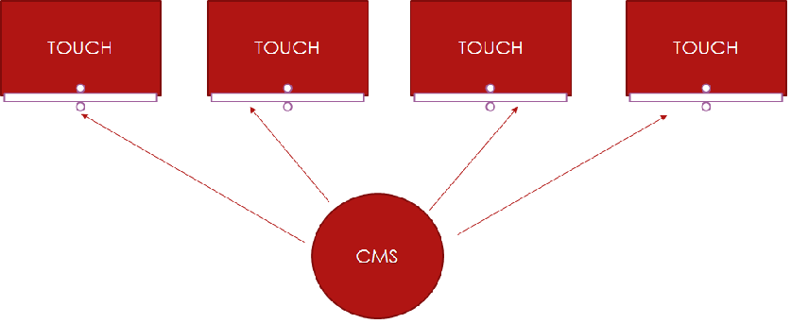



WHAT NOW ?
Notes:
Poly has been using commercial signage system ,
My job is to Use the research, mvp to make it interactive.

Slide 7
Development Pathway
Developed an application that detects users and display message accordingly.
Further extending the functionality, technical advisor taking it to the client.

